Slide 1
Introduction to Autosar Diagnostics and Diagnostics Communication Manager (DCM)

Slide 2
Vehicle Diagnostics
Vehicle Diagnostics helps to analyze the health of a vehicle, by checking the diagnostic data.
Diagnostic Data is classified as:
Current Data: Data available at the moment of request, keeps changing
Stored Data: Data copied and stored during an event
Static Data: eg: manufacture date
Terminologies:
DID (Data Identifier)
DTC (Diagnostic Trouble Code)
RID (Routine Identifer)

Slide 3
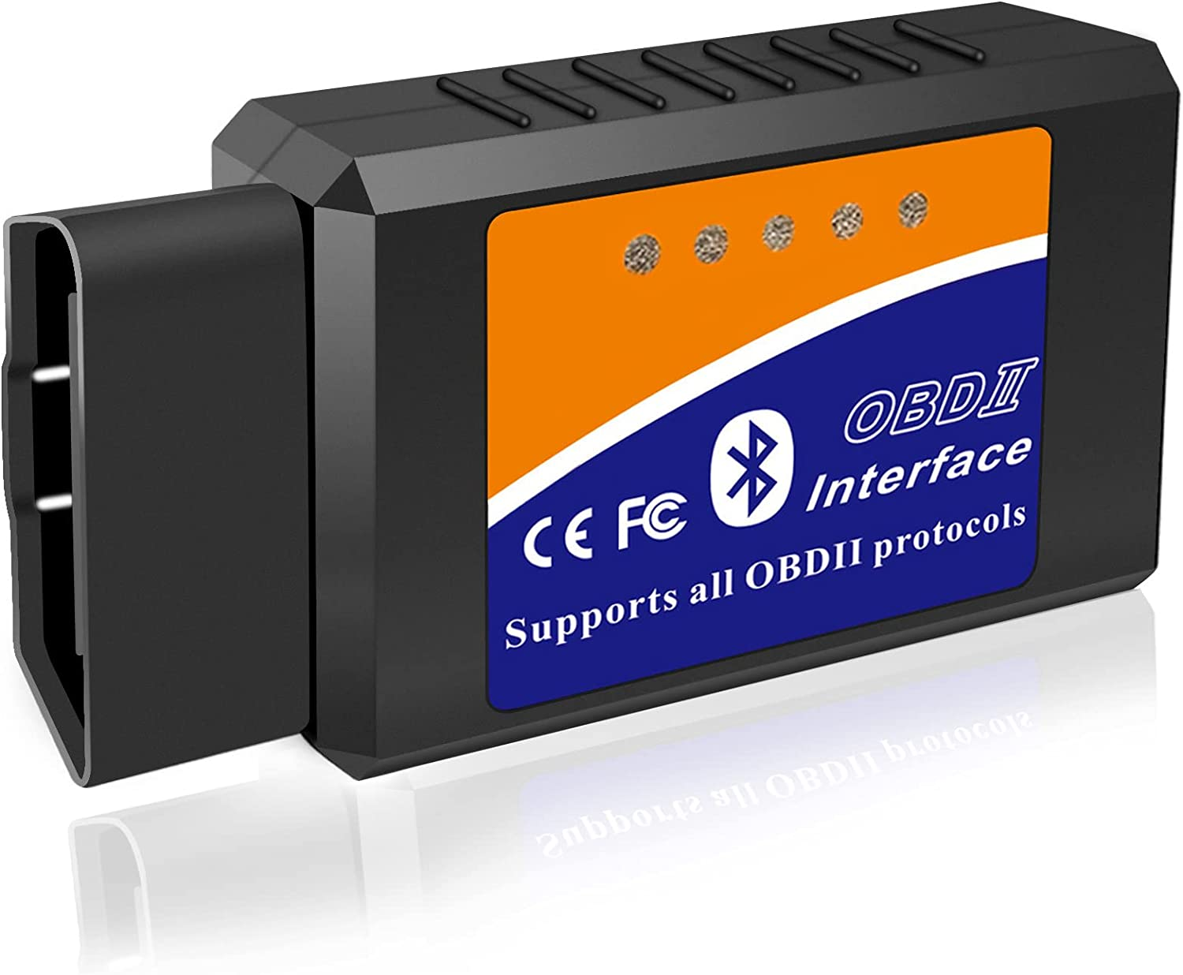
Vehicle Diagnostics
They are classified as On Board Diagnostics (OBD) and off board diagnostics (UDS – Unified Diagnostics Services)
OBD is the vehicle’s built in diagnostics setup, earlier which used to use MIL (Malfunction Indicator Light) and these days provide communication interface through which real time data and fault related data (Diagnostic Trouble Codes – DTCs) can be queried.

Slide 4
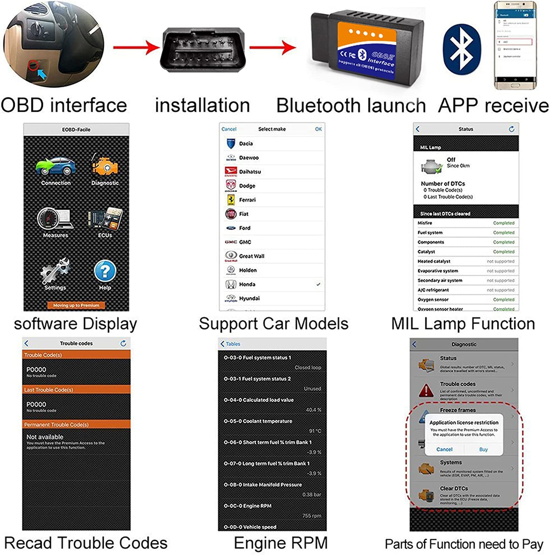
OBD Diagnostics

Slide 5
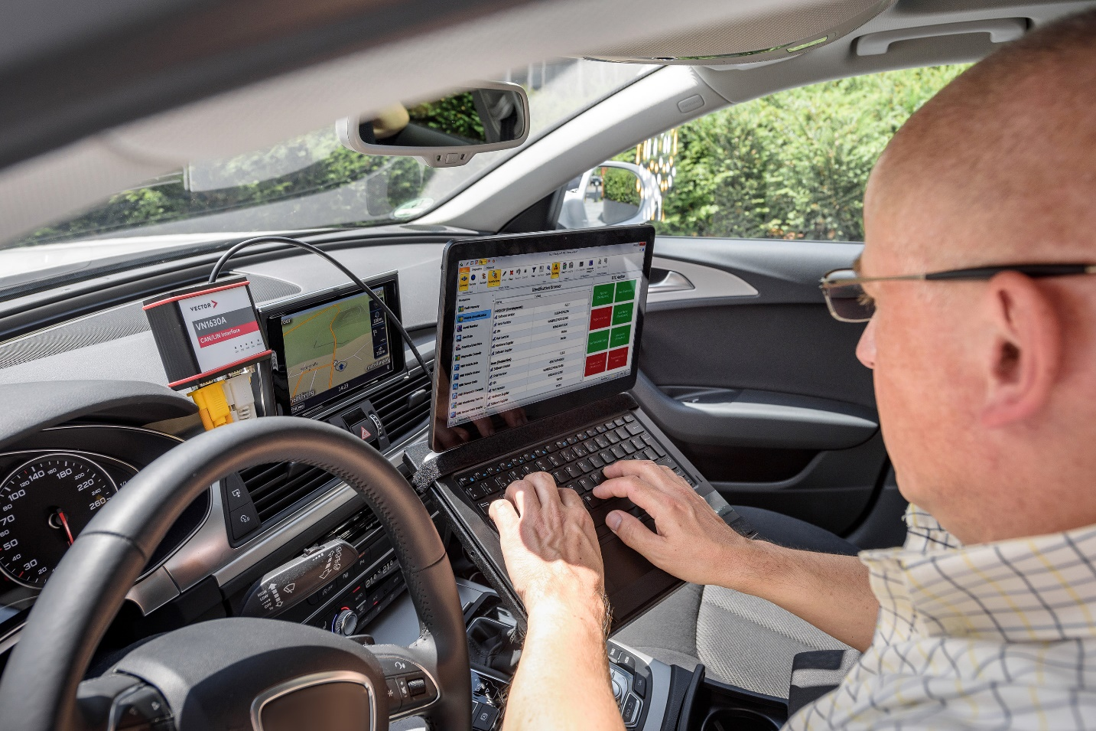
Off-Board Diagnostics:UDS Services
Off-board Diagnostics uses the UDS (Unified Diagnostics Services) Protocol ISO 14229-1, which needs a separate tester setup, like a laptop with Client Tester software installed.
This is to be connected to the vehicle’s off-board diagnostic interface.
Now UDS service requests can be sent to the controller, which must respond either with a positive or negative response

Slide 6
Off-Board Diagnostics:UDS Services
Diagnostic Session: State of the server in which a specific set of diagnostic services are enabled.
Default Session (0x01): ECU starts up to this session and continues in it unless changed
Programming Session (0x02): for server programming
Extended Diagnostic Session (0x03): Enables all/majority of the diagnostic services
Safety System Diagnostic Session (0x04): Enables services related to safety system

Slide 7
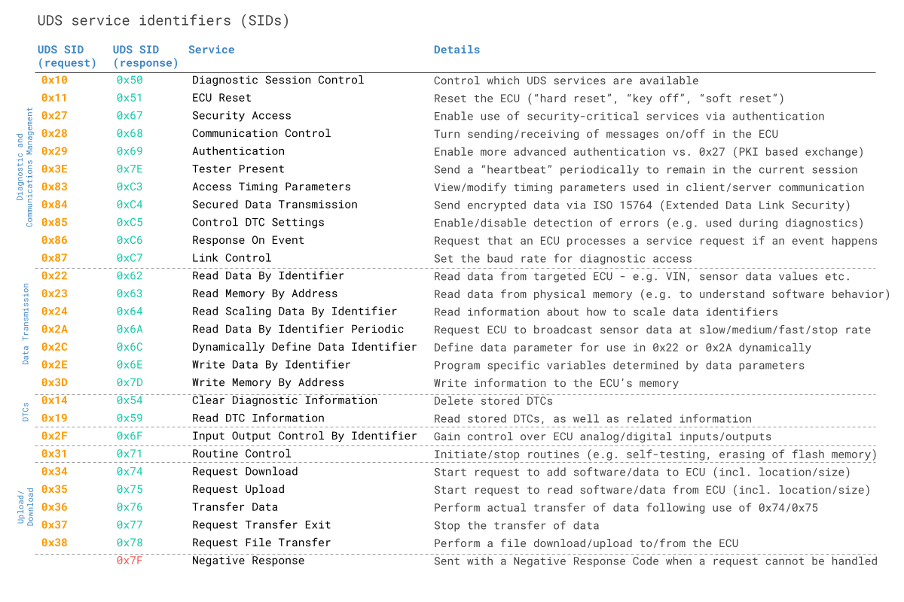
UDS Services

Slide 8
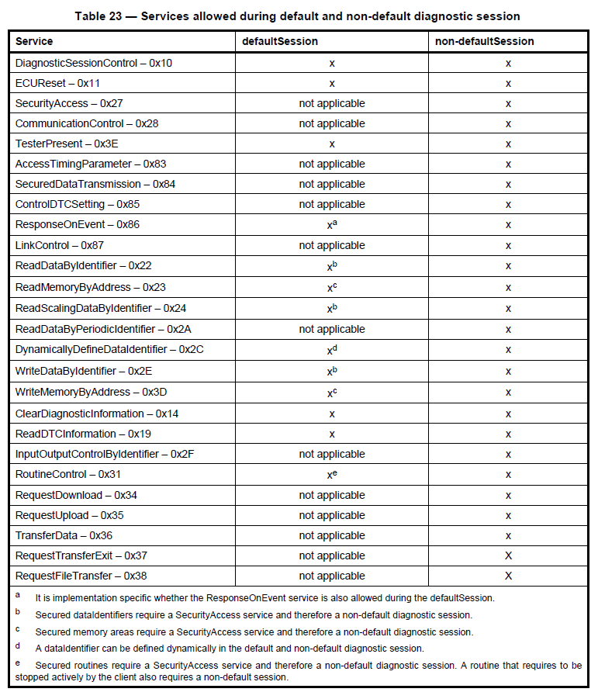

Slide 9
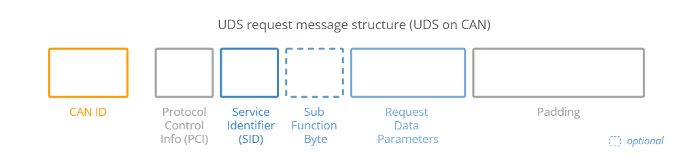
UDS Services: Request Message Structure
PCI (Protocol Control Information): Contains information related to CAN-TP, which deals with transmission of messages which cannot be fit into a single CAN Frame. It can be 1-3 bytes long.
Service Identifier (SID): ID of the UDS service to be used. (1 Byte)

Slide 10
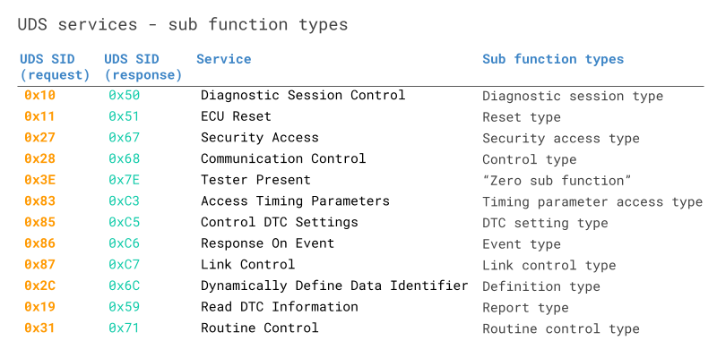
UDS Services : Request Message Structure
Sub-function Byte: Some services requires additional data (similar to arguments in a function call). Is 1 byte long and can have up to 128 sub function values using 7 bits (7th bit is used for positive response enable/disable-0/1 resp). This is optional.

Slide 11
UDS Services : Request Message Structure
Request Data Parameters: Used to give further configuration of a request beyond the Sub Function Bye. For example when using 0x22 “Read Data by Identifier” Service, this field can used to provide the DID (Data Identifier).
Padding: To keep the total size of the CAN data frame fixed as 8 bytes.

Slide 12
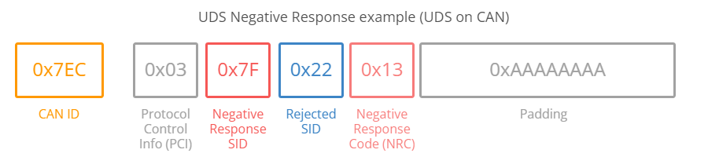
UDS: Positive & Negative Response
The ECU can respond positively or negatively to a UDS request.
The Positive response follows a similar structure as the request and will contain the requested data if applicable. The response SID is the request SID+0x40. For example if the request SID is 0x22, then the response SID will be 0x62.
The ECU will give a negative responses in some cases, which is structured in the following CAN frame format:

Slide 13
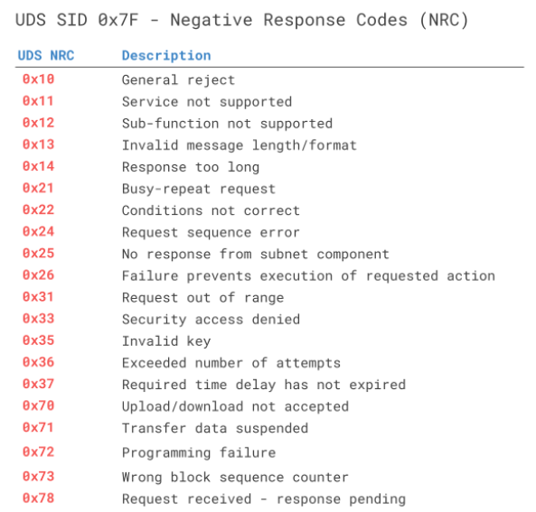
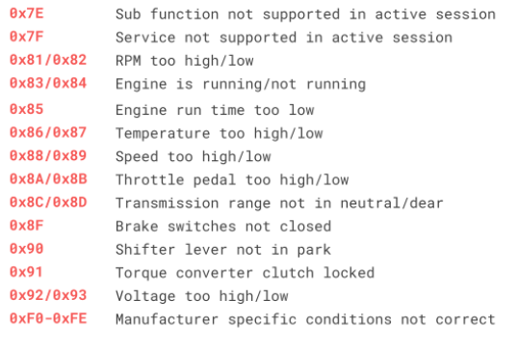
UDS: Negative Response

Slide 14
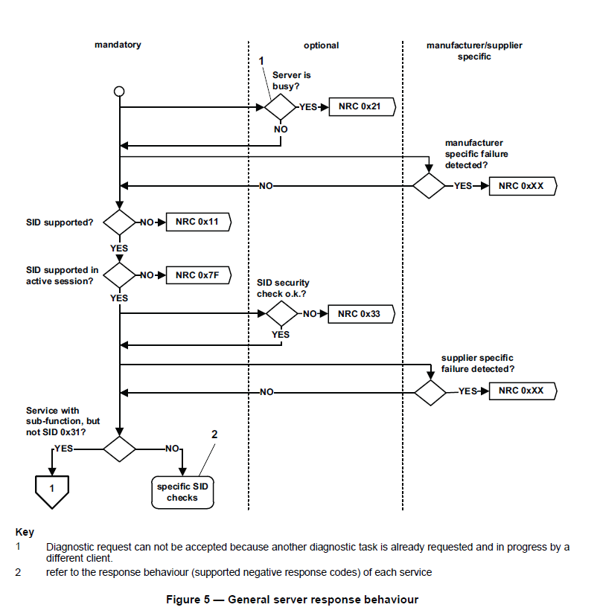

Slide 15
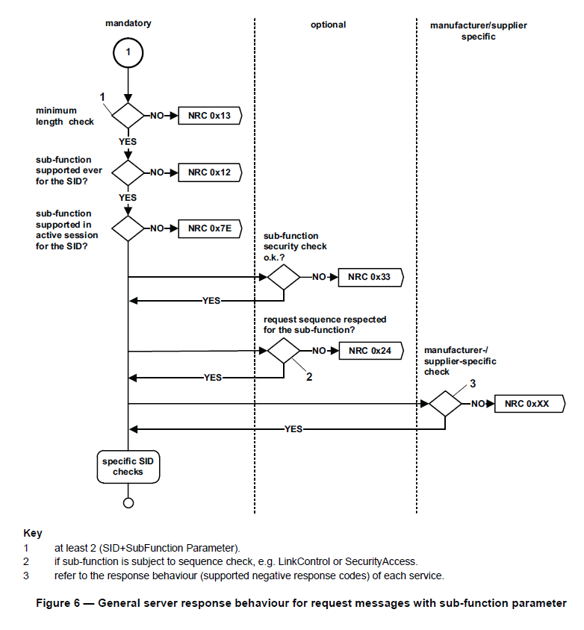

Slide 16
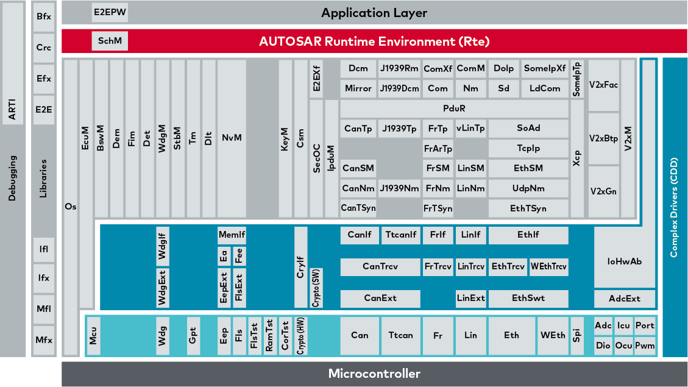
Diagnostics: AUTOSAR Software Stack
Correction: no memory space for DID, processed when requested by runnables

Slide 17
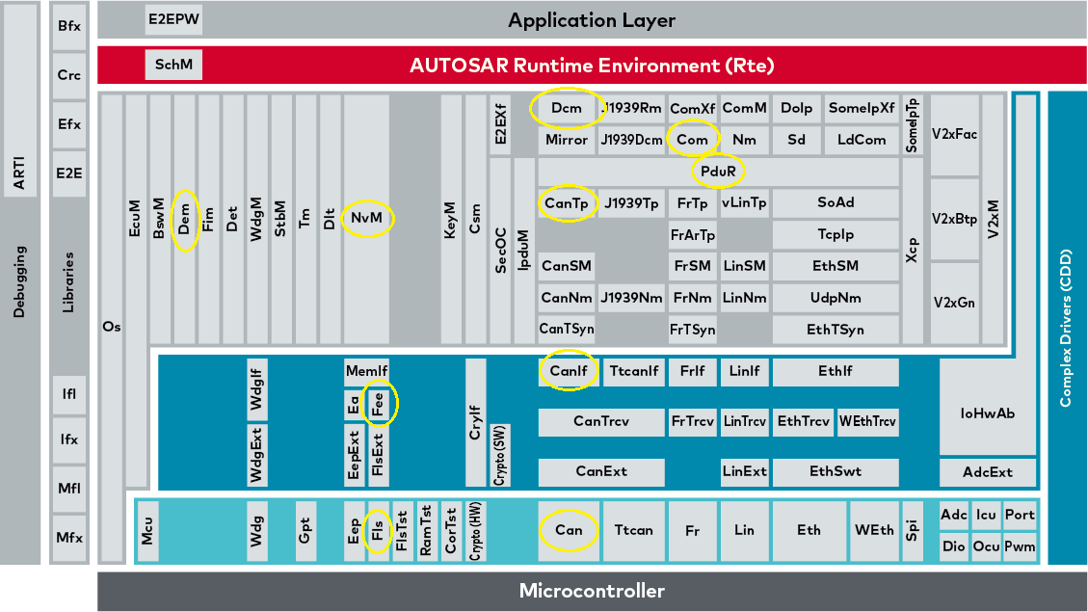
Diagnostics: AUTOSAR Software Stack

Slide 18
Diagnostics: AUTOSAR BSW Software Stack
DCM (Diagnostics Communication Manager):
Manages communication between the tester and the ECU
Analyzes and understands the diagnostics communication as per the ISO-14229-1 UDS standard
Implements the UDS Services
Stores and manages fault related data with the help of DEM
Does precondition check before service execution (session control and security access)
DEM (Diagnostic Event Manager): Responsible for processing diagnostic events, storing the related data (DTCs) to the NvM (Non Volatile Memory) and also providing the same to the DCM.
CAN: CAN driver stack in the MCAL layer which manages the CAN transceiver.
CANIF (CAN Interface): Present in the ECU Abstraction layer. Provides interface for the upper layer to manage the CAN Driver.

Slide 19
Diagnostics: AUTOSAR BSW Software Stack
CANTP (CAN Transport Protocol): Responsible for segmentation, transmission and reception of CAN frames having payload higher than 8 bytes. Follows the ISO 15765 CAN TP standard.
CAN TP – ISO 15765
CAN TP (Transport Protocol) is used when the data size to be transmitted is bigger than 8 bytes, ie maximum data size in a single CAN frame.

Slide 20
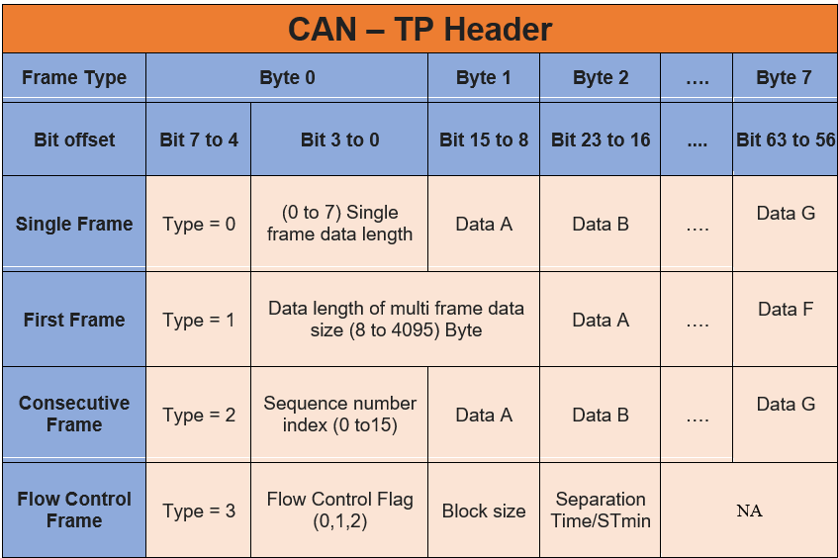
CAN TP – ISO 15765
Under CAN-TP, there are 4 frame types, as explained in the image given. All 4 frames are differentiated using the type number.
During normal CAN transmission with data size < 8 bytes, only single frame is use. When the data size is greater than 8 bytes, then the rest 3 frames are used.
The flow of frames is explained in the image given.

Slide 21
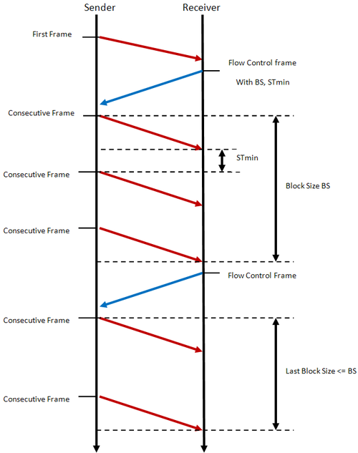
CAN TP – ISO 15765
Initially the Sender sends the first frame is sent with the total data size, which can vary from 8 to 4095 bytes (4KB).
The receiver then sends the Flow control frame with flow control flag, BS and Stmin
Block size is the number of consecutive frames to be sent for now. The Receiver can request the data to be sent part by part with different block sizes as per its processing capability. It can also make sender wait if required using the flow control flag. Block size 0 means no limit set.
Stmin is the minimum separation time between the frames
flow control flag:
FS = 0: Clear to Send.
FS = 1: Wait.
FS = 2: Overload.

Slide 22
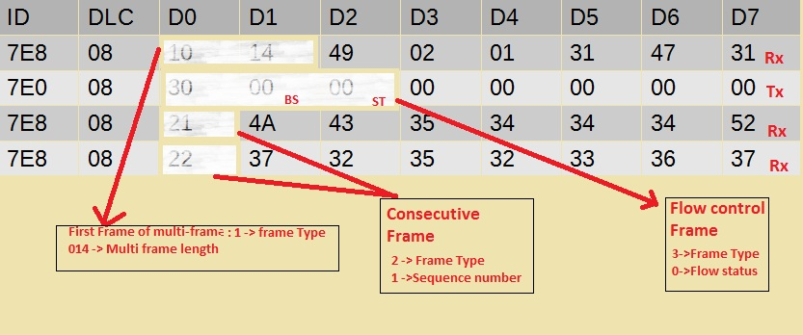
CAN TP – ISO 15765

Slide 23
Diagnostics: AUTOSAR BSW Software Stack
PDUr (PDU Router): PDUr routes the PDU to the respective Bus specific interface modules. (PDU: Protocol Data Unit – can be roughly considered as a package of signals. Signals are smallest amount of information in a CAN message, ranging from 1 to 64 bits). The PDUr is also responsible for routing the CAN frame to CAN-TP if the payload is greater than 8 bytes.
COM (Communication Stack): Responsible for packing and unpacking of PDUs into signals and vice-versa. It provides signal oriented interface to the application layer (independent of protocol) and PDU oriented access to the lower layers.

Slide 24

Diagnostics: AUTOSAR Software Stack

Slide 25
Diagnostics: AUTOSAR BSW Software Stack
NVM (Non Volatile Memory Stack): Responsible for the read and write functions to the non volatile memory. For example, DEM stores all the DTC related information in the non-volatile memory.
Fee (Flash EEPROM Emulation) Module: Present in the ECU Abstraction layer. Provides interface to the upper layer NVM to access the flash driver.
FLS (Flash) Driver: Driver Stack in MCAL layer used to read and write from the flash memory. Call from NVRAM manager is passed to FEE module and FEE to FLS.
EA (EEPORM Abstraction) Module: Present in the ECU Abstraction layer. Provides interface to the upper layer NVM to access the EEPROM driver.
EEP (EEPROM) Driver: Driver Stack in MCAL layer used to read and write from the EEPROM memory. Call from NVRAM manager is passed to EA module and EA to EEP.

Slide 26
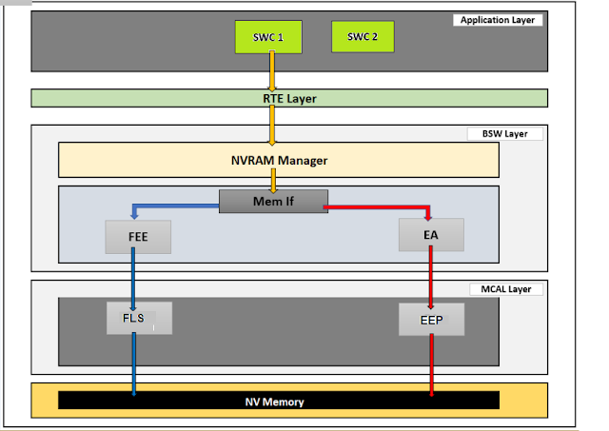
Diagnostics: AUTOSAR BSW Software Stack

Slide 27
Further Resources
CAN TP ISO 15765: https://www.youtube.com/watch?v=hSoLFaI4-qg
ISO 14229 UDS:
https://desoeap16.delta.corp/svn/IPB_PPE_auto_porsche/trunk/20_Design/23_Software/2310_HowTo/HowTo_Diagnostics/ISO_14229-1_2013-03.pdf
TechnicalReference_Dcm.pdf
https://desoeap16.delta.corp/svn/External_IPB_auto_pag/trunk/20_Design/23_Software/2304_Implementation/10_APPL/10_ComController/1001_Common/70_Tools/10_AR_ToolChain/Components/Dcm/Documentation/TechnicalReference_Dcm.pdf

Slide 28
Smarter. Greener. Together.

